Slide 1
Design of a robot to assist nasopharyngeal swap sampling
Saad Abuzaid Saad

Slide 2
Table of Contents
1
3
2
4
Background Reading
Technical achievements
Background Reading about the project
Technical achievements during challenge week
Project Objectives
Project Managment
Project Objectives, Implementation plan, risks, context
A record of summer and challenge week activity on Jira

Slide 3
Introduction
Would you trust a robot to do your nasopharngyeal swab sample?

Slide 4
1
Background Reading

Slide 5
Background Reading
Nasopharyngeal swab sample
Why robots would be favoured over humans
Similar projects
My technique, and improvements

Slide 6
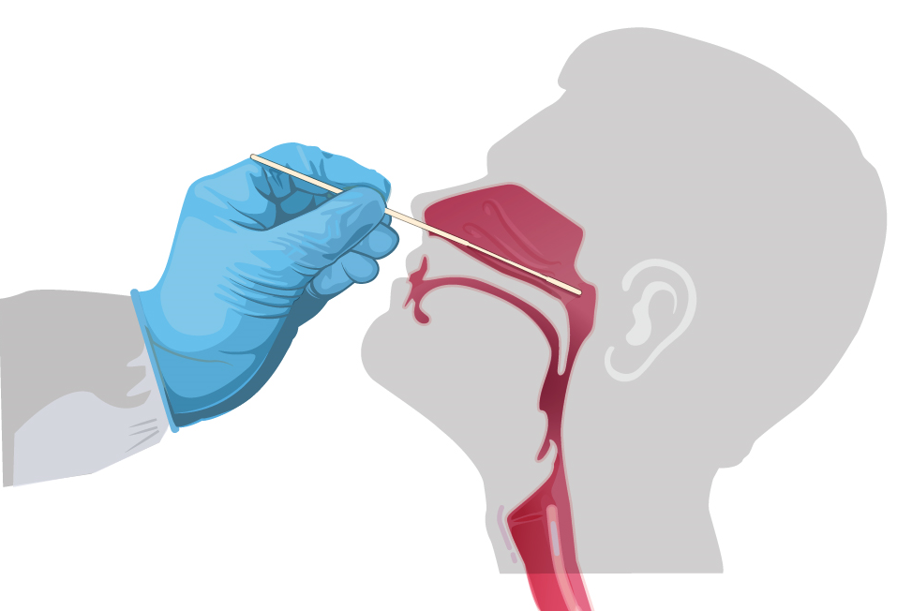
Nasopharyngeal swab sample
Gently insert the swab along the nasal septum, just above the floor of the nasal passage, to the nasopharynx, until resistance is felt.
Leave the swab in place for several seconds, rotate the swab in place, and then slowly the swab.
Put the swab in the collection tube carefully.

Slide 7
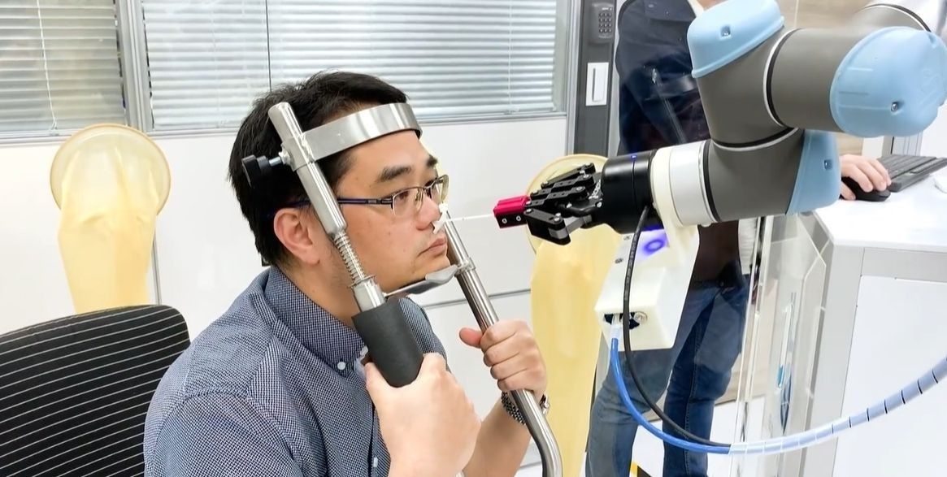
Why robots would be favoured
Human Errors
Complications might happen after NP swab sampling
Robot’s accuracy

Slide 8
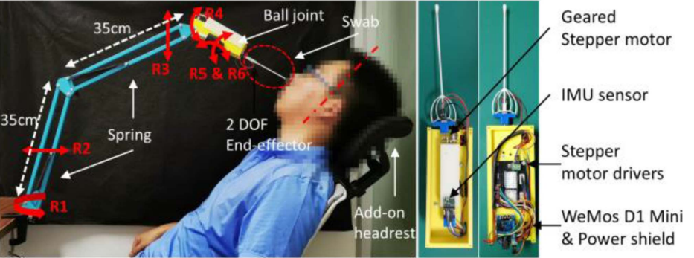
Similar Project
Advantages
Low cost
Light weight
Disadvantages
Lacks full-automation
Infectious

Slide 9
My technique, and improvements
My technique explained
Full-automation improvement
Proposed solutions to disinfect robot’s grip

Slide 10
Project Objectives
Creating robot arm, or finding suitable robot
Finding suitable software simulation(In case couldn’t access robot)
Programming this robot
Control unit
Disinfection setup
Nostril detection, and tracking
User interface

Slide 11
Risks
Miscalculation, and errors
Robot’s grip handling
Face, and nostril detection
User Interface
Electrical fires
Infection

Slide 12
Technical achievments
Installing OpenCV, and integrating its libraries with IntelliJ
Watched tutorials about computer vision
Implemented a class that can detect faces, and nostrils.

Slide 13

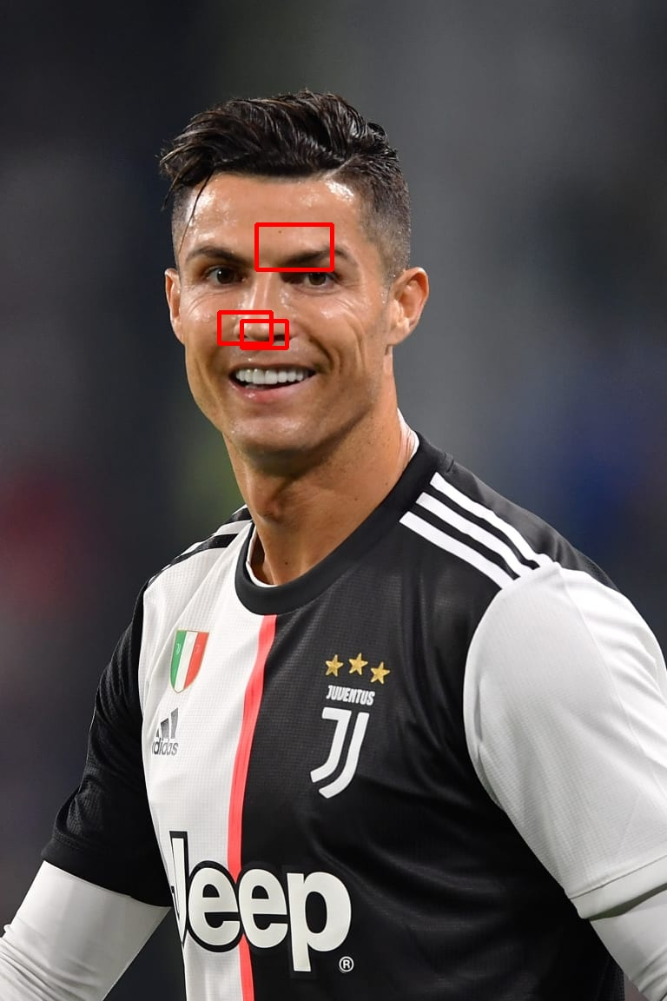
Technical achievments
Face & Nostril Detection:

Slide 14
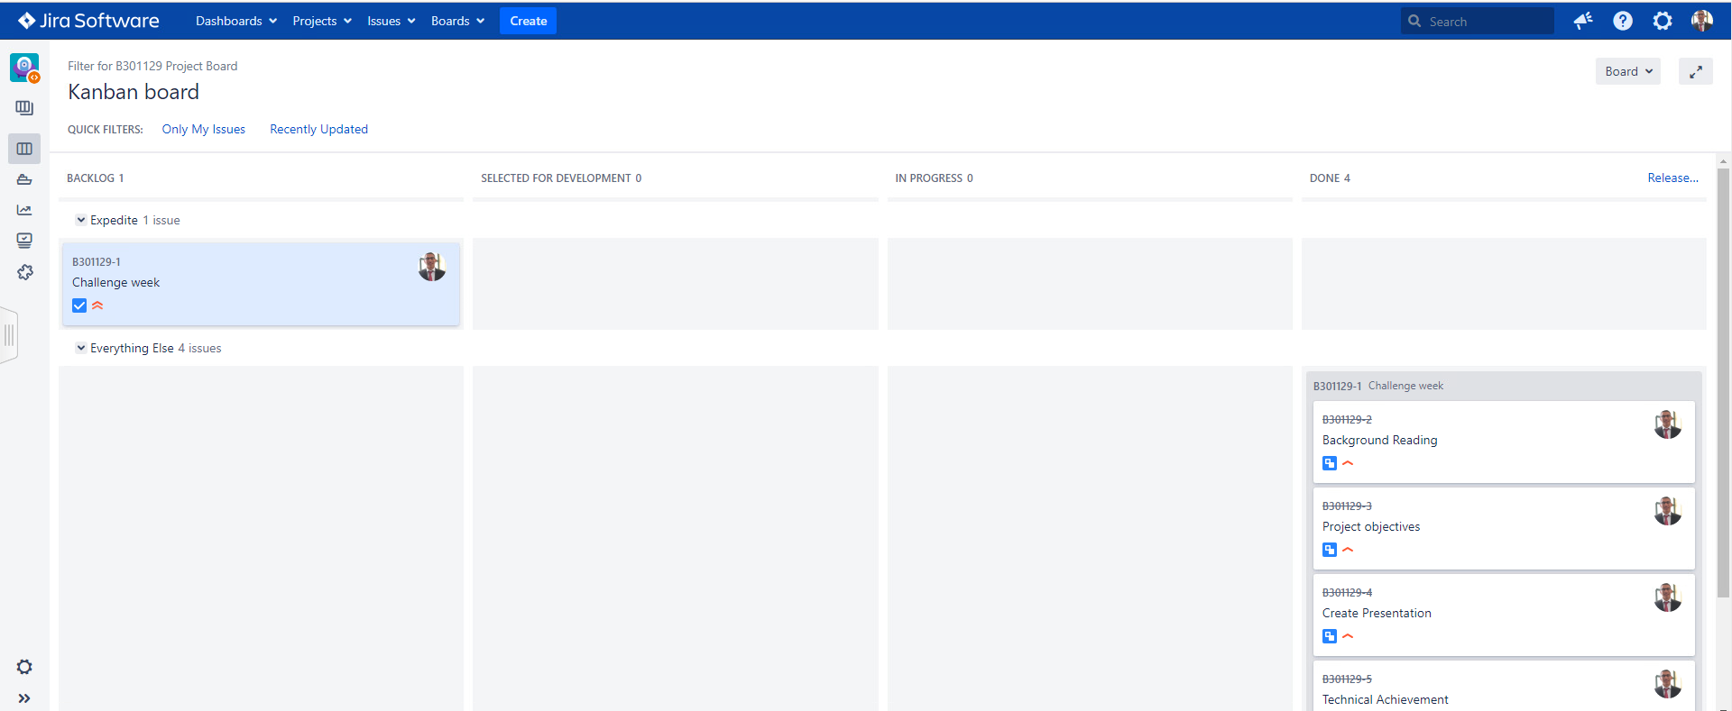
Project Managment
Jira Backlog:

Slide 15
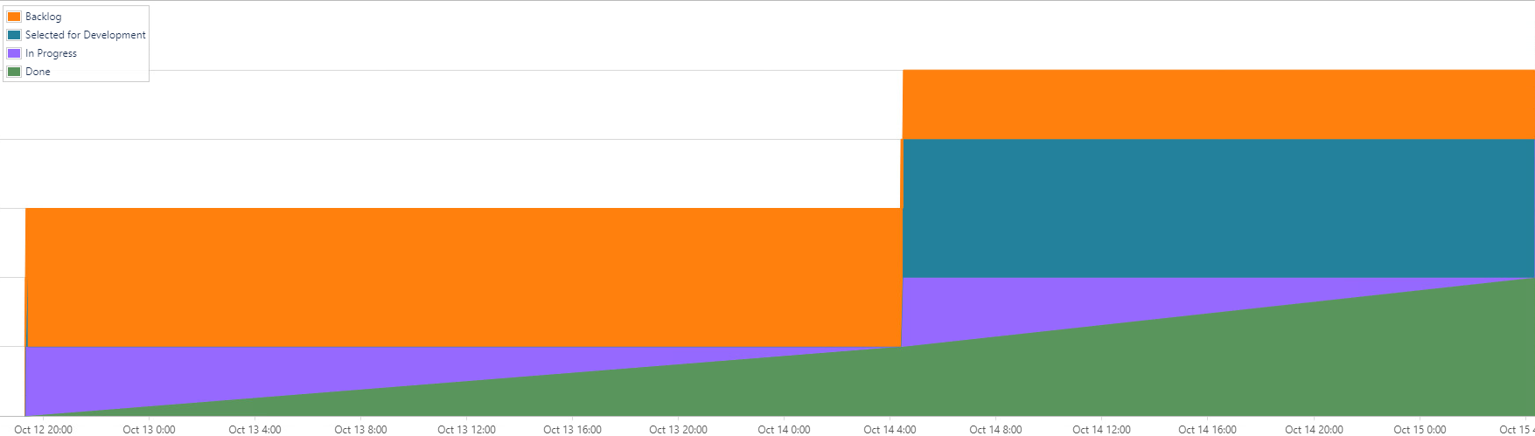
Project Managment
Jira Cumulative Flow Diagram:

Slide 16
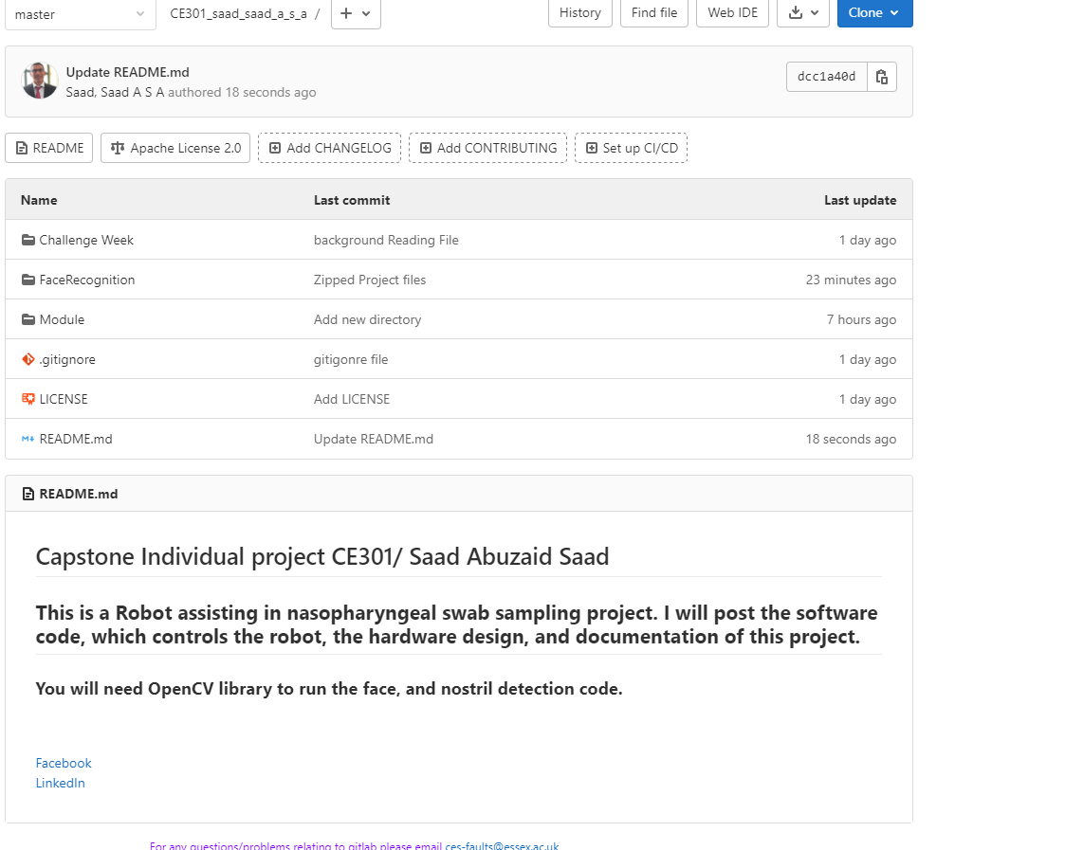
Project Managment
Uploaded evidence to Gitlab:

Slide 17
Questions?

Slide 18
Thanks!

